Slide 1














Power BI
Project
Credit Card Financial Dashboard
Yash Shukla

Slide 2
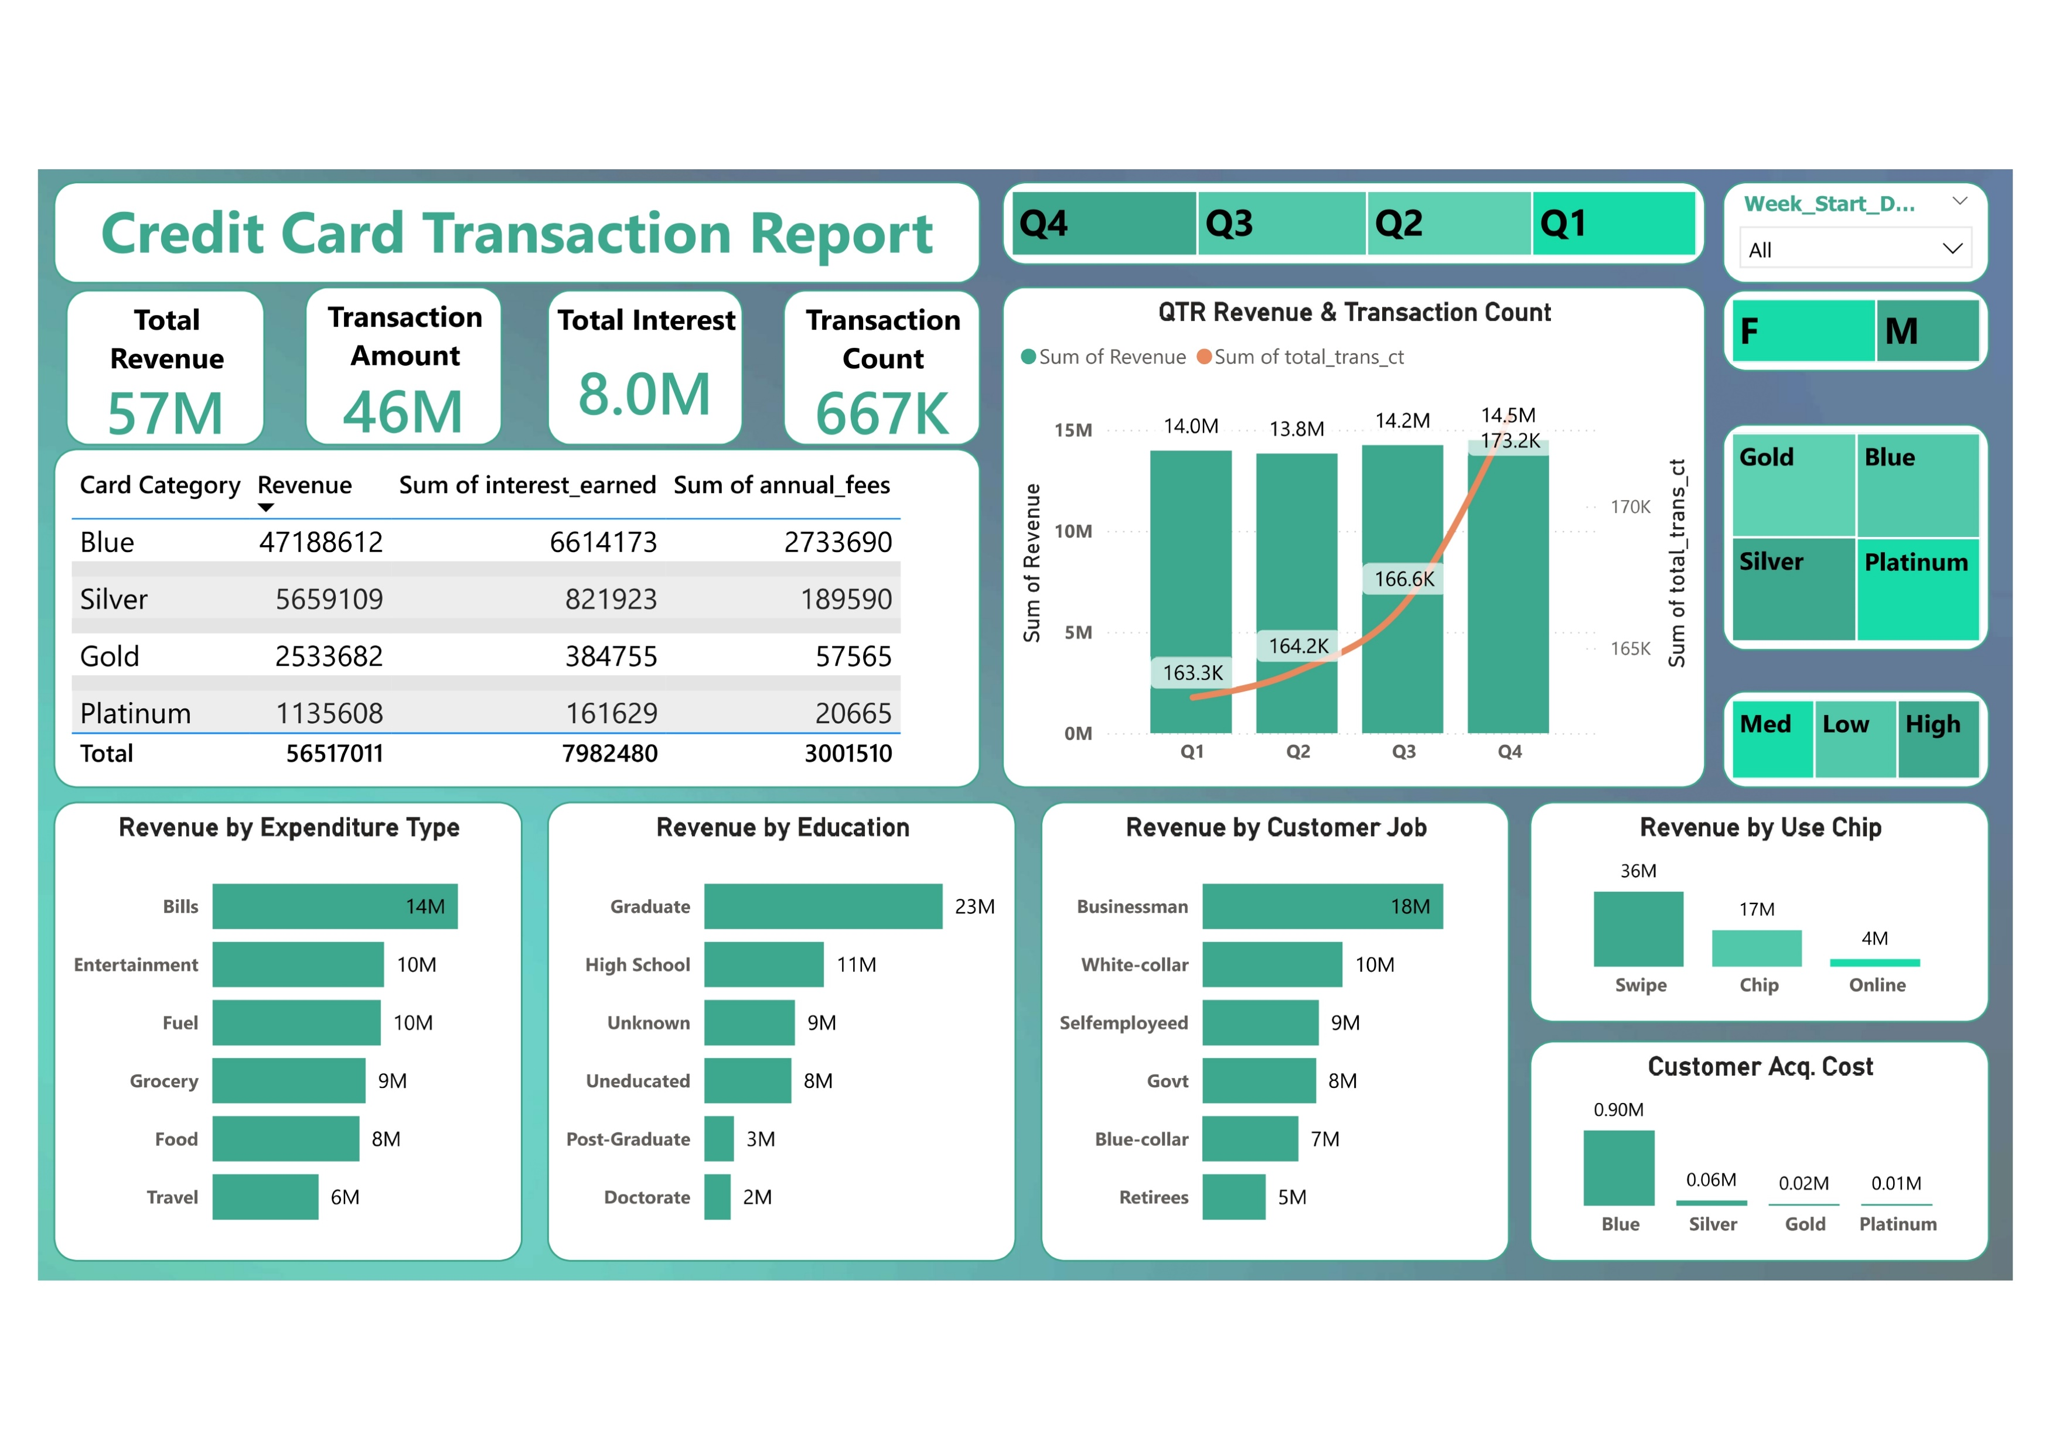

Slide 3
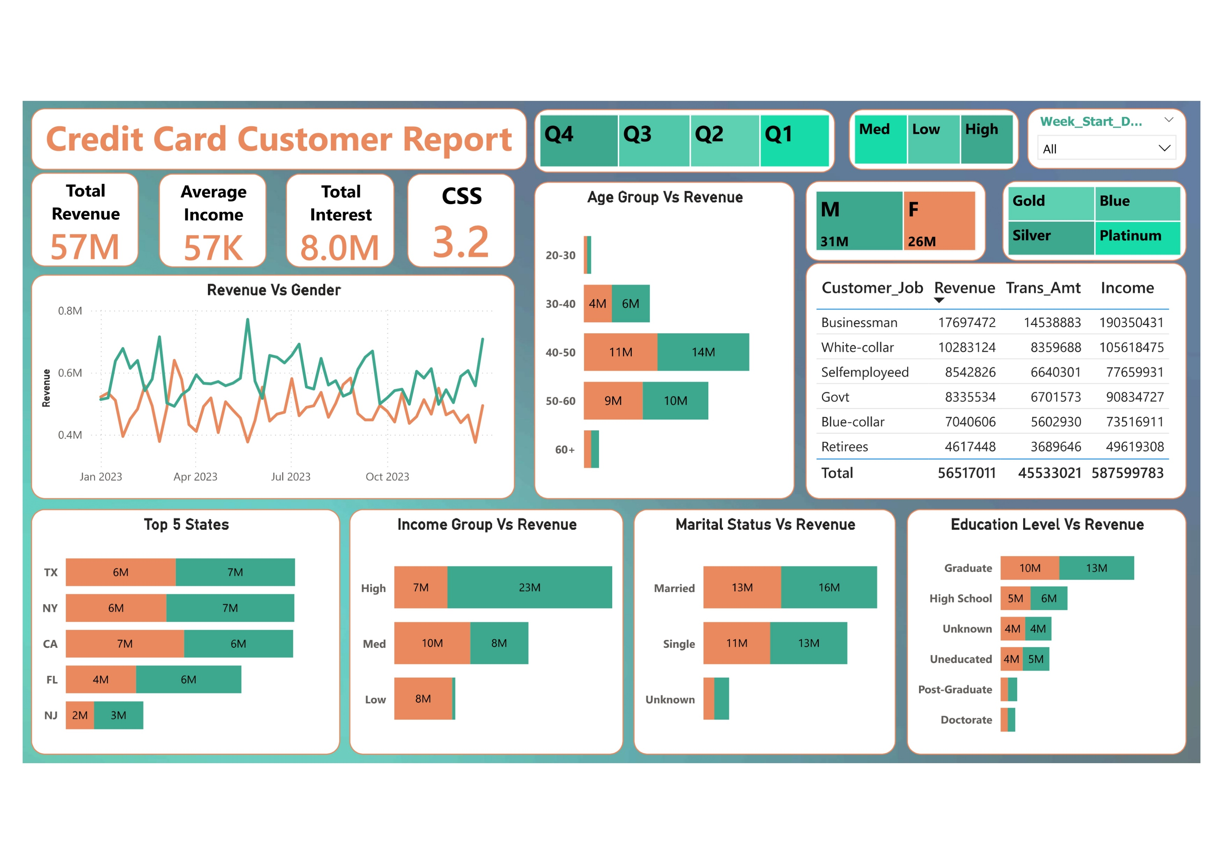

Slide 4
Project Objective
This project aims to create a robust credit card dashboard capable of delivering up-to-date information on crucial performance indicators. By offering a clear and concise overview of key metrics and trends, this dashboard will empower stakeholders to make informed decisions, identify potential issues, and optimize credit card operations.

Slide 5




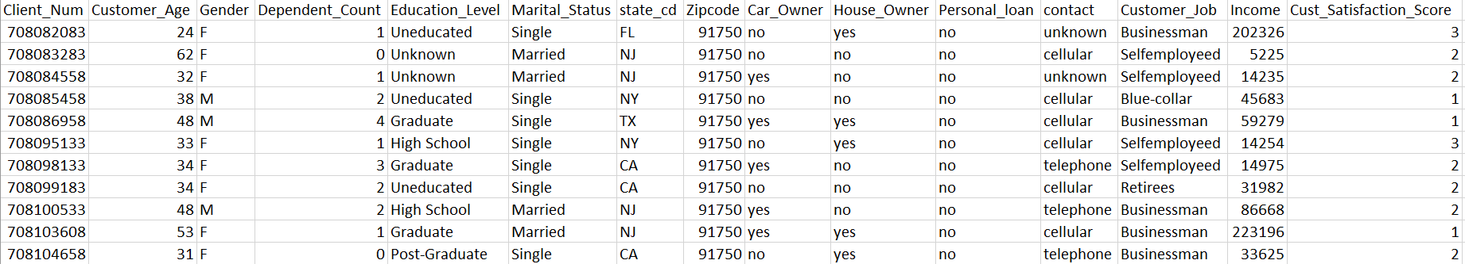


Data : Customer
Client_Num, Customer_Age, Gender, Dependent_Count, Education_Level, Marital_Status, state_cd, Zipcode, Car_Owner, House_Owner, Personal_loan, contact, Customer_Job, Income, Cust_Satisfaction_Score

Slide 6
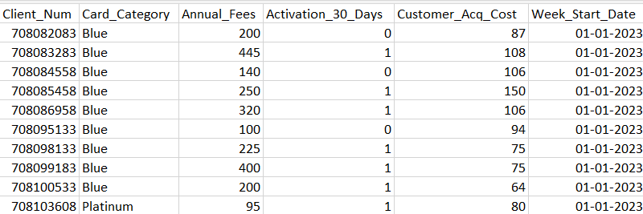
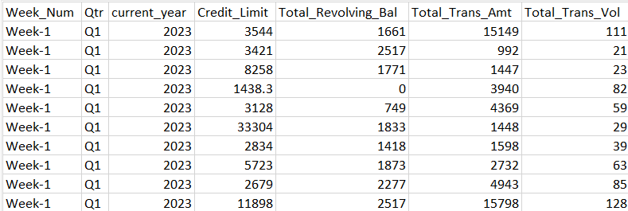
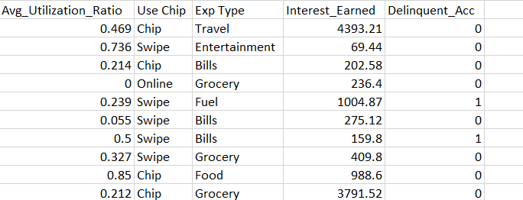
Data :
Card Transaction
Card_Category, Initial_Activation, Days_to_30_Days_Delinquency, Customer_Acquisition_Cost, Week_Start_Date, Week_Number_Current_Year, Credit_Limit, Total_Revolving_Balance, Total_Transactions_Amount, Total_Transaction_Volume, Average_Utilization_Rate, Most_Used_Chip_Type, Expenses, Interest_Paid, Last_Statement_Date, Delinquency_Status

Slide 7

Import Data To SQL DataBase
Create Database
Create Tables For Each Csv File With Same Header Names
Copy Data Through CSV to SQL DataBase.

Slide 8
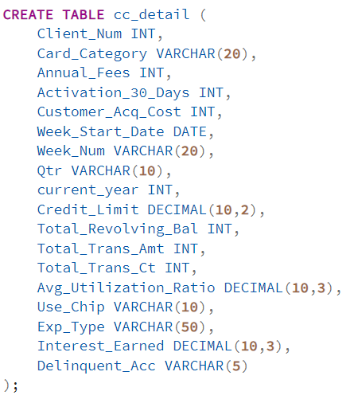
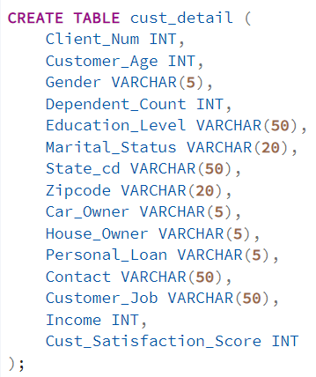

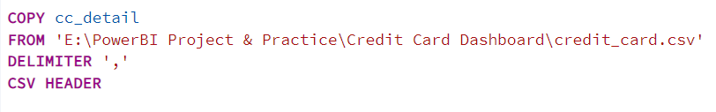
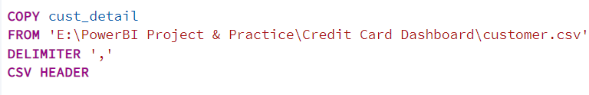
Create Table: Card Transaction
Create Table: Customer
Create DataBase
Copy: Card Transaction Data
Copy: Customer Data

Slide 9
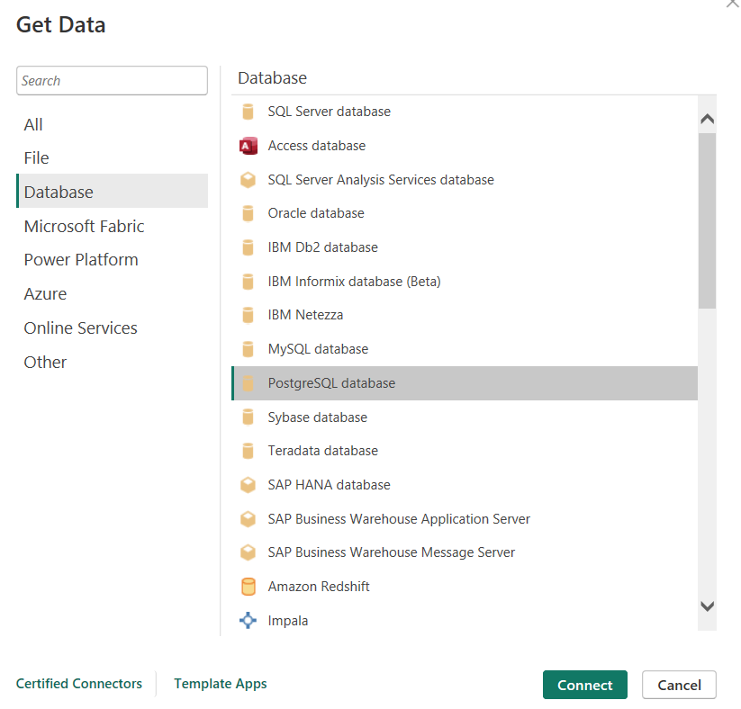
Load / Get Data In Power BI

Slide 10
DAX Measures and Their Purpose
1. AgeGroup
Purpose: Categorizes customers into age groups based on their customer_age.
Example: Customers aged 25-30 would be assigned to the "20-30" group.
2. IncomeGroup
Purpose: Categorizes customers into income groups based on their income.
Example: Customers with an income between $35,000 and $70,000 would be assigned to the "Med" group.
3. week_num2
Purpose: Calculates the week number of a given week_start_date.
Example: If week_start_date is January 1st, 2024, week_num2 would be 1.
4. Revenue
Purpose: Calculates the total revenue for a customer based on annual fees, total transaction amount, and interest earned.
Example: If a customer has annual fees of $100, total transaction amount of $500, and interest earned of $20, their Revenue would be $620.
5. Current_week_Reveneue
Purpose: Calculates the total revenue for the current week.
Example: If the current week is week 10, this measure would sum the Revenue for all customers in week 10.
6. Previous_week_Reveneue
Purpose: Calculates the total revenue for the previous week.
Example: If the current week is week 10, this measure would sum the Revenue for all customers in week 9.

Slide 11

DAX Queries
Age Group
Income Group
AgeGroup = SWITCH(TRUE(),
'public cust_detail'[customer_age] < 30, "20-30",
'public cust_detail'[customer_age] >= 30 && 'public cust_detail'[customer_age] < 40, "30-40",
'public cust_detail'[customer_age] >= 40 && 'public cust_detail'[customer_age] < 50, "40-50",
'public cust_detail'[customer_age] >= 50 && 'public cust_detail'[customer_age] < 60, "50-60",
'public cust_detail'[customer_age] >= 60, "60+",
"unknown"
)
IncomeGroup = SWITCH( TRUE(),
'public cust_detail'[income] < 35000, "Low",
'public cust_detail'[income] >= 35000 && 'public cust_detail'[income] <70000, "Med",
'public cust_detail'[income] >= 70000, "High",
"unknown" )
Revenue
Week_num2
week_num2 = WEEKNUM('public cc_detail'[week_start_date])
Revenue = 'public cc_detail'[annual_fees] + 'public cc_detail'[total_trans_amt] +
'public cc_detail'[interest_earned]
Current_Week_revenue
Previous_Week_Revenue
Current_week_Reveneue = CALCULATE(
SUM(
'public cc_detail'[Revenue]),
FILTER( ALL('public cc_detail'), 'public cc_detail'[week_num2]
= MAX('public cc_detail'[week_num2])))
Current_week_Reveneue = CALCULATE(
SUM(
'public cc_detail'[Revenue]),
FILTER( ALL('public cc_detail'), 'public cc_detail'[week_num2]
= MAX('public cc_detail'[week_num2])-1))

Slide 12
Insights
Optimizing Credit Card Performance: A Strategic Approach
Credit Card Performance Overview
Revenue: Up 28.8% WoW; YTD: $57M
Transactions: Total Amount: $46M
Customers: Activation Rate: 57.5%
Interest Income: $8M YTD
Gender Contribution:
Males: $31M | Females: $26M
Card Types: Blue & Silver: 93% of Transactions
Top States: TX, NY, CA contribute 68% of Revenue
Delinquency Rate: 6.06%
By strategically targeting key demographics, leveraging partnerships, and optimizing product offerings, you can effectively increase credit card usage and revenue. Continuously monitor performance metrics, analyze customer feedback, and adapt your strategies to meet evolving market trends and customer preferences.

Slide 13



Thank you very much!
Yash Shukla

